Slide 1

Introduction to Node.js
ELECTIVE 3

Slide 2
What is Node
Node is a runtime environment for executing JS code outside of a browser.
We often use Node to build back-end services also called APIs (Application Programming Interface)
API – is the services that powers the client applications like Web App running in web browser or Mobile App running in mobile devices.
Web App and Mobile App are just a surface, they need to communicate something on the server or in the cloud to store data, send emails, push notifications and so on.

Slide 3
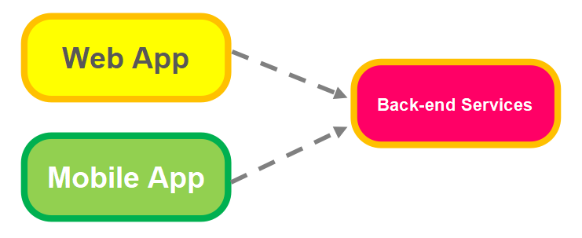

Slide 4
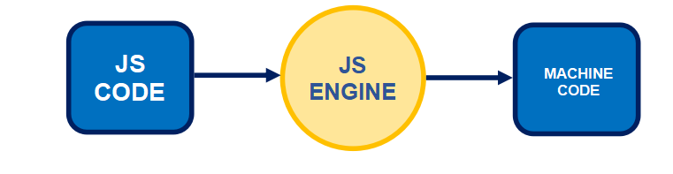
Node Architecture
Brief History
Before Node, we used JavaScript only to build applications that runs in a browser. Every browser has a JS Engine that takes our JS code and convert it into a code that computer can understand.

Slide 5
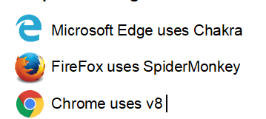
Example of JS Engine

Slide 6
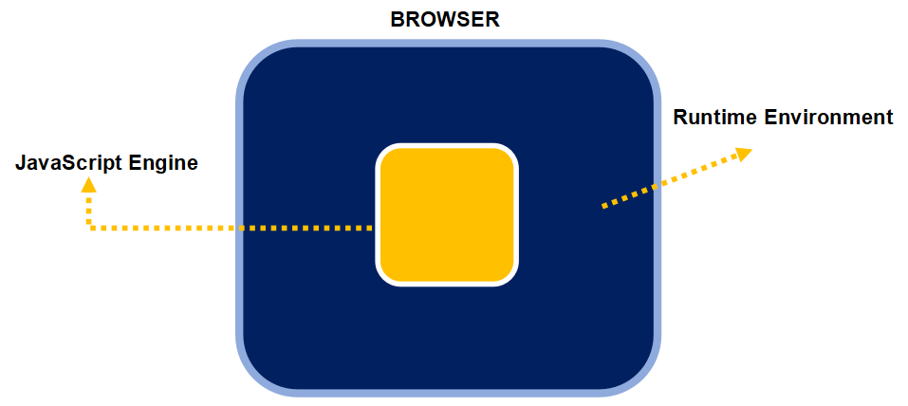
A browser provides a runtime environment for JS Code.

Slide 7


For Example, your probably know that in browsers we have the window or the document object.
Note: Node is NOT a programming language
Node is NOT a framework
It is a runtime environment for executing JavaScript code

Slide 8
How Node Works
We already mention that node is Highly Scalable, data-intensive and real-time apps, it is because of none-blocking or asynchronous nature of node.

Slide 9
What is asynchronous?
Image you go to a restaurant, a waiter comes to your table takes your order and go to the kitchen and then they move on to serve another table while the chef are preparing your meal, so, one person can serve many different tables.
hey don’t wait for the chef to cook one meal before they serve another table, this is what we call non-blocking or asynchronous architecture, and this is how node applications work.

Slide 10
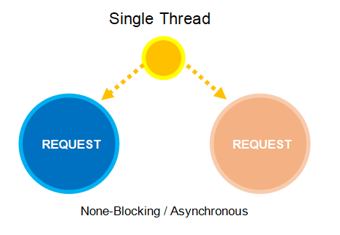
A single thread is used to handle multiple requests.

Slide 11
What is synchronous?
Again, imagine you go to another restaurant and in this restaurant a waiter is allocated to you. The waiter takes your order and go to the kitchen, and this time the waiter do not do anything else they are just waiting, they are not going to serve another table until your meal is ready. This is what we call blocking or synchronous architecture.
And that how the applications built with frameworks like asp.net or rails.

Slide 12
Node Queue
Node applications are asynchronous by default, you don’t need to do anything extra. In node we have single thread to handle all requests.
When a request arrives, that single thread are used to handle that requests, if you need to query to the database, that single thread doesn’t have to wait for the database to return the data. While the database are executing our query that thread will be used to serve another client when the database return the results it puts a message in what we called an Event Queue. Node is monitoring this queue in the background, when it finds an event in this queue it will take it out and process it.

Slide 13
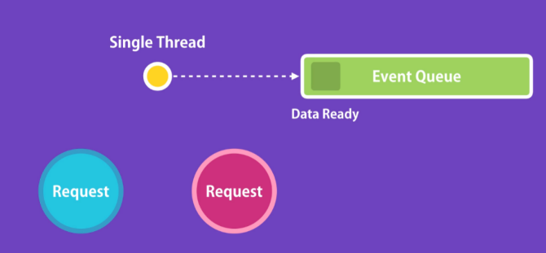
Node Queue
This kind of architecture is ideal for I/O-intensive applications that include a lot of disk or network access, we can serve more client without throwing in more hardware.
And that’s why node applications are highly scalable.

Slide 14


Installing Node
How to Install Node?
Check if you have already node in your machine or not.
Open command prompt or CMD and type this command and press enter.
You will see this output if you already have node.

Slide 15
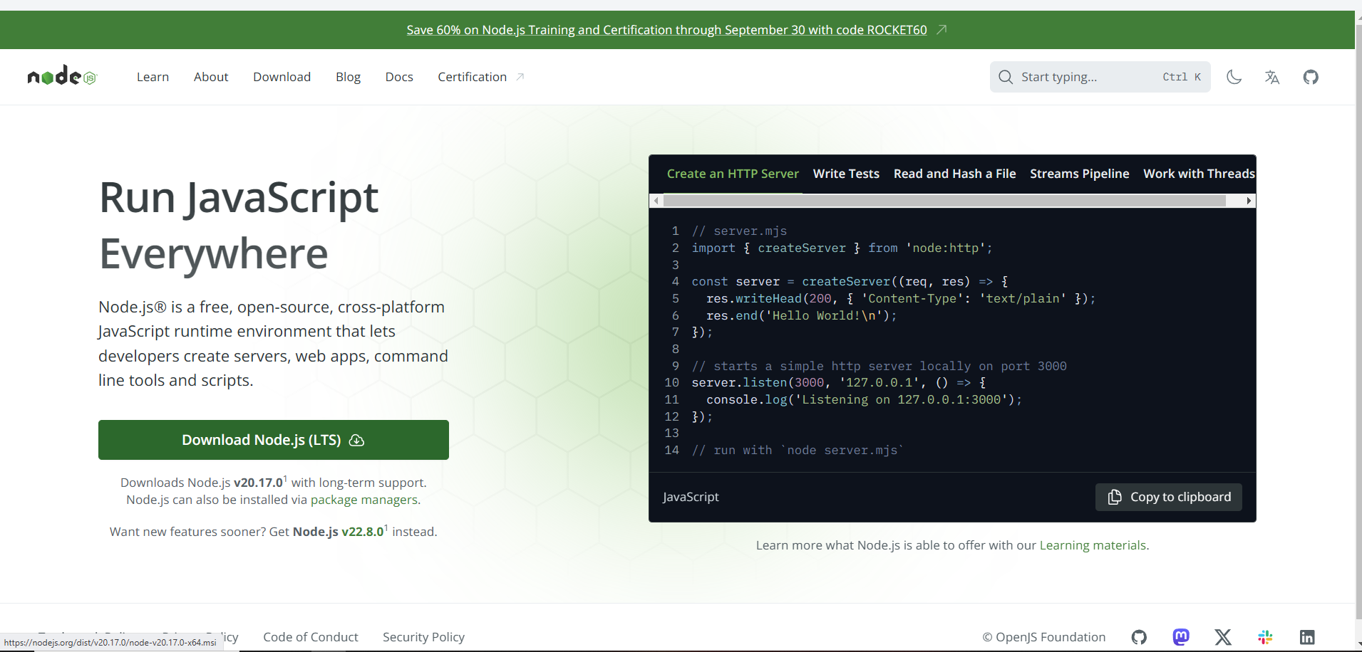
Installing Node
Open your browser and go to nodejs.org

Slide 16

Installing Node
In installation follow the directions.
Check again in the CMD by running again the command and press enter.

Slide 17
Creating first Node program
Now we are ready to build our first node application. To organize the files that we need throughout this course we need to create a folder where we can put all our files.
Anyway, we need a Visual Studio Code which is prefer code editor for this module. You can use any other code editor such as sublime or notepad++.

Slide 18
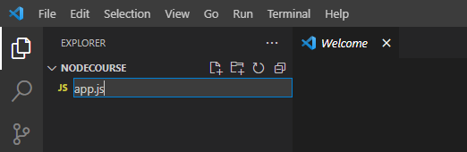
Let start building or first Node program.
Create a new file app.js.

Slide 19
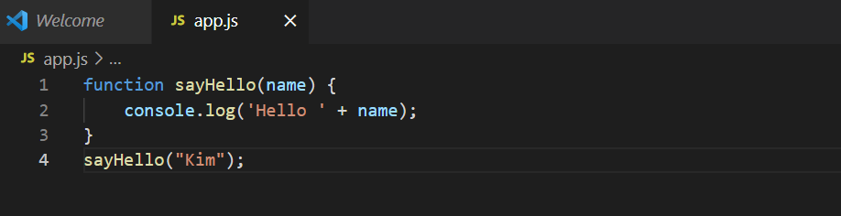

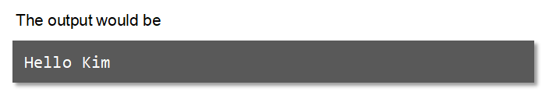
And in this file, we can write a simple JS code like we are writing in a browser.
To run this code, back to the terminal
Enter this command and press enter

